Slide 1
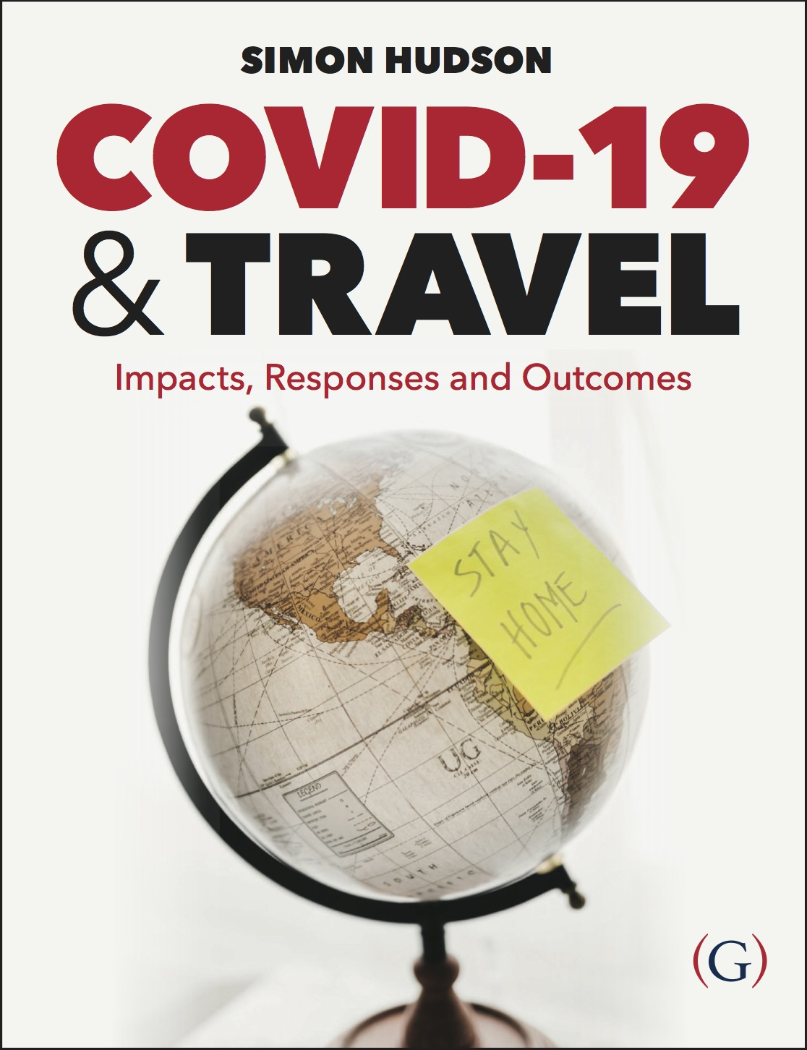
Chapter 1: An unfolding crisis

Slide 2
Topics Covered
Case Study: How the cruise industry became a symbol of COVID-19
The outbreak
Pandemic
Stranded
Case Study: COVID-19 and the meltdown of ski resorts

Slide 3
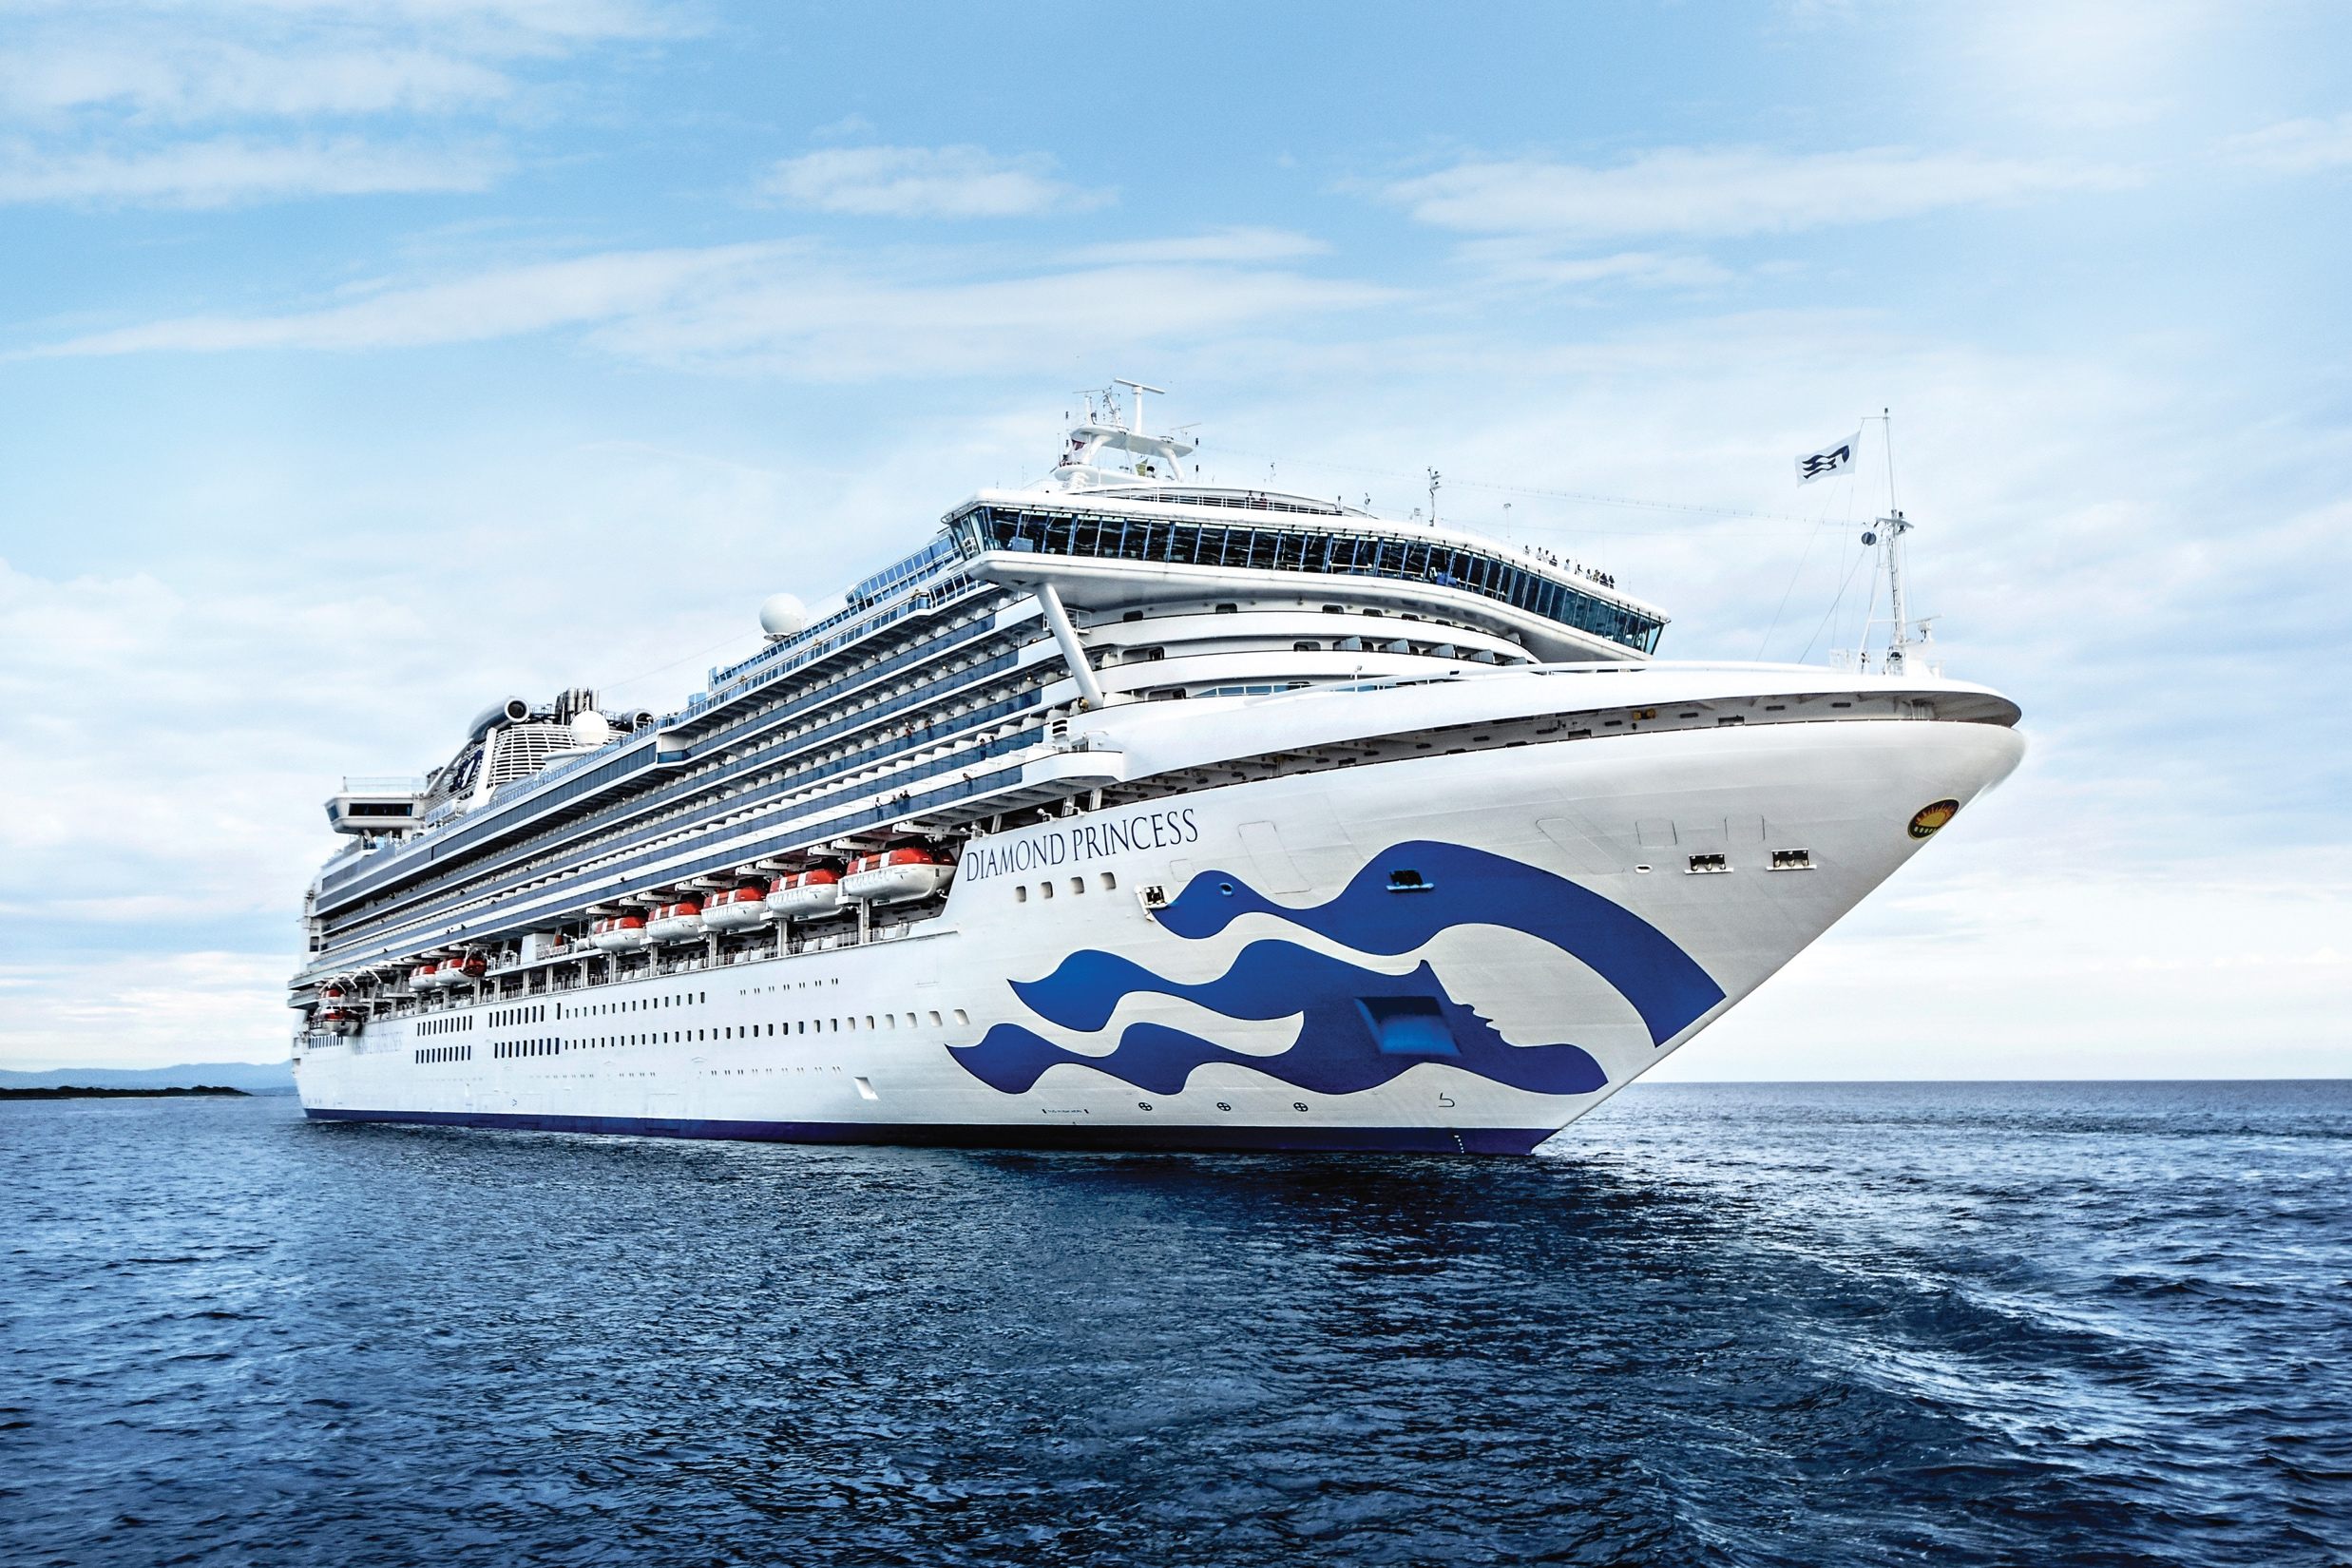
Case Study: How the cruise industry became a symbol of COVID-19
Until COVID-19, the cruise sector was one of the most successful and dynamic subsectors of the global tourism industry.
Early in 2020, COVID-19 infected passengers aboard Carnival’s Diamond Princess
Out of the ship’s 3,711 passengers and crew, 712 eventually tested positive
The cruise industry suddenly went from being the golden child of the tourism sector to a sober symbol of the deadly disease.
Carnival’s response to the coronavirus outbreak raised questions about corporate negligence and fleet safety.

Slide 4

The outbreak
At the end of December 2019, public health officials from China informed the World Health Organization that they had a problem: an unknown, new virus was causing pneumonia-like illness in the central Chinese city of Wuhan.
The World Health Organization (WHO) named the disease caused by the virus COVID-19, which references the type of virus and the year it emerged.
It was early February when COVID began to have a potent impact on the travel sector – first in Asia

Slide 5

The outbreak
In Europe in the last week of February, with the news that 11 towns in Italy were on lockdown, and countries like Austria and Croatia had announced their first cases, it was apparent that the impact of COVID-19 was likely to be felt on a more global scale than was perhaps previously envisaged.
Italy was the first European country to lockdown

Slide 6
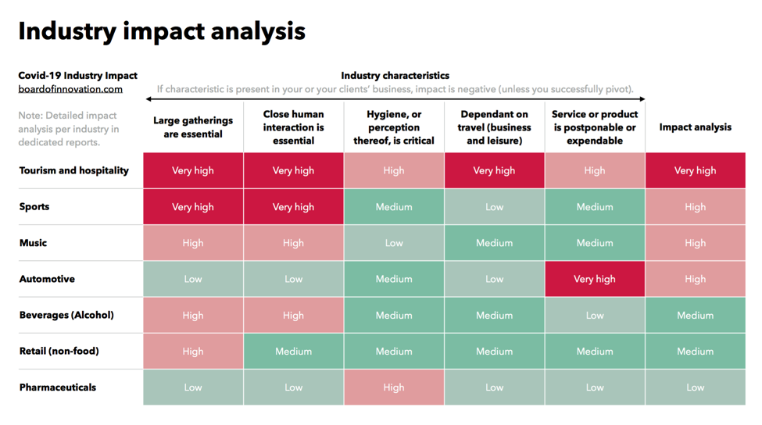
Travel and tourism may be the one industry to see the greatest impact from the coronavirus

Slide 7

Pandemic
The crisis struck during the key pre-summer booking period for many travel companies - travel disruptions began to be commonplace.
In the attractions sector, Shanghai Disney was among the first major global attractions to close its doors – that was in late January - followed in short order by all of Asia's Disney-themed parks.
On March 11, the World Health Organization declared that COVID-19 was a pandemic, and countries began to close borders.

Slide 8
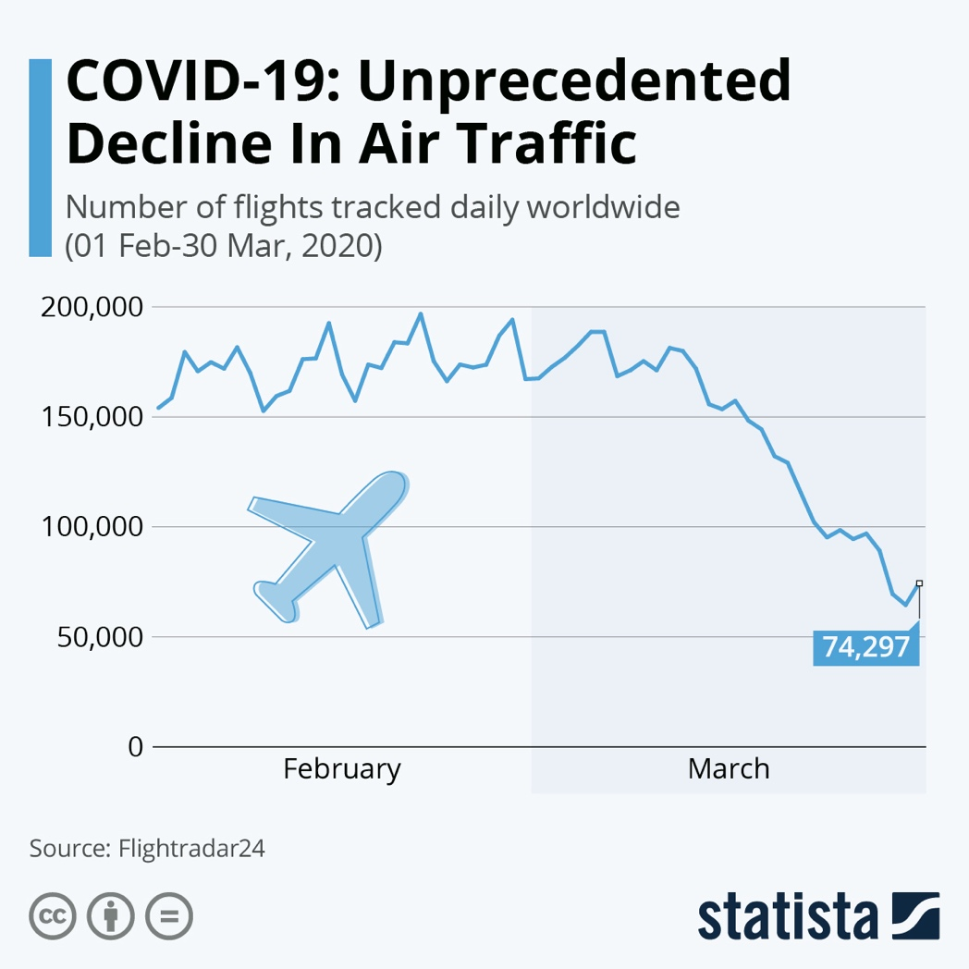
COVID-19 caused huge of disruption to the global airline industry

Slide 9
Pandemic
By the end of March 2020, governments in many countries – for example, top tourism destinations like Spain - had ordered the closure of their hotels, and business and leisure travel was almost at a standstill.
On a positive note, China’s hotel sector was showing signs of recovery at this time, with daily hotel occupancy showed reaching an absolute level of 31.8 percent on March 28, up from a low of 7.4 percent during the first week of February

Slide 10
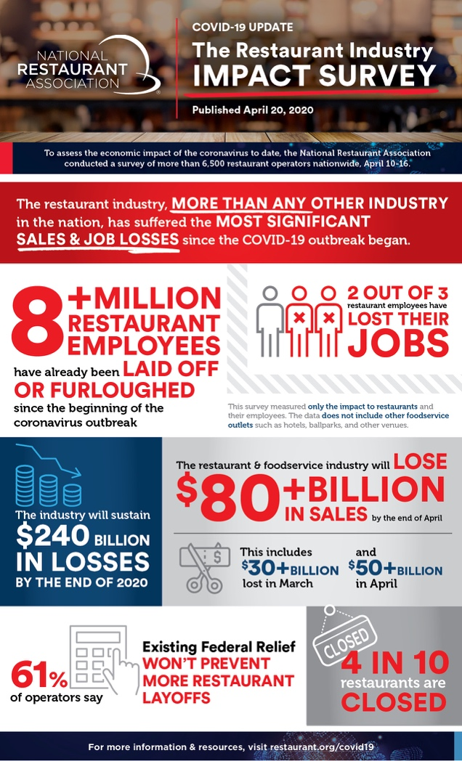
How the pandemic initially impacted the restaurant sector in the US

Slide 11
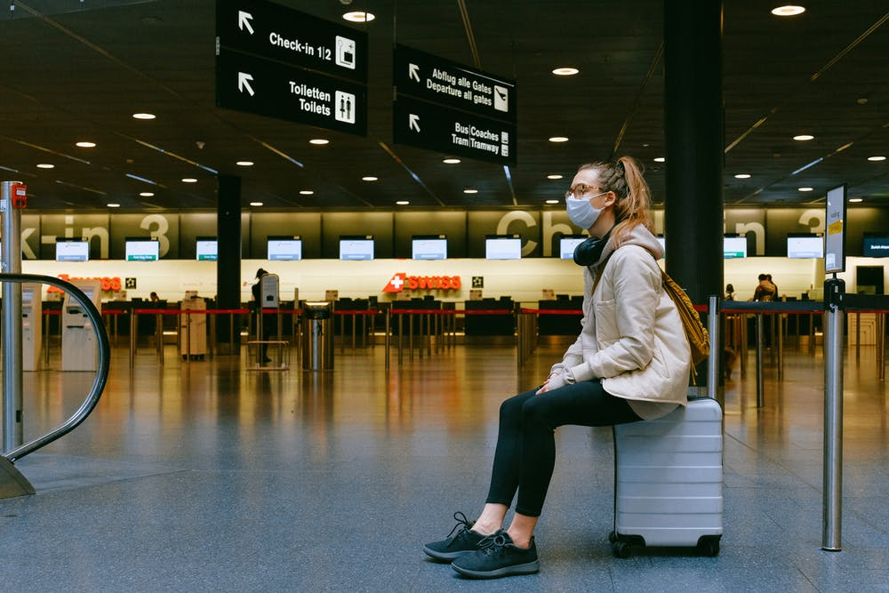
Stranded
By late March with the coronavirus spreading at a rapid pace, most governments had introduced strict controls on domestic and foreign travel, which left many tourists trapped abroad.
Thousands were stranded in Nepal, Sri Lanka and other locations across Asia, and foreign governments stepped up their efforts to repatriate them.
Some governments reacted faster than others.

Slide 12
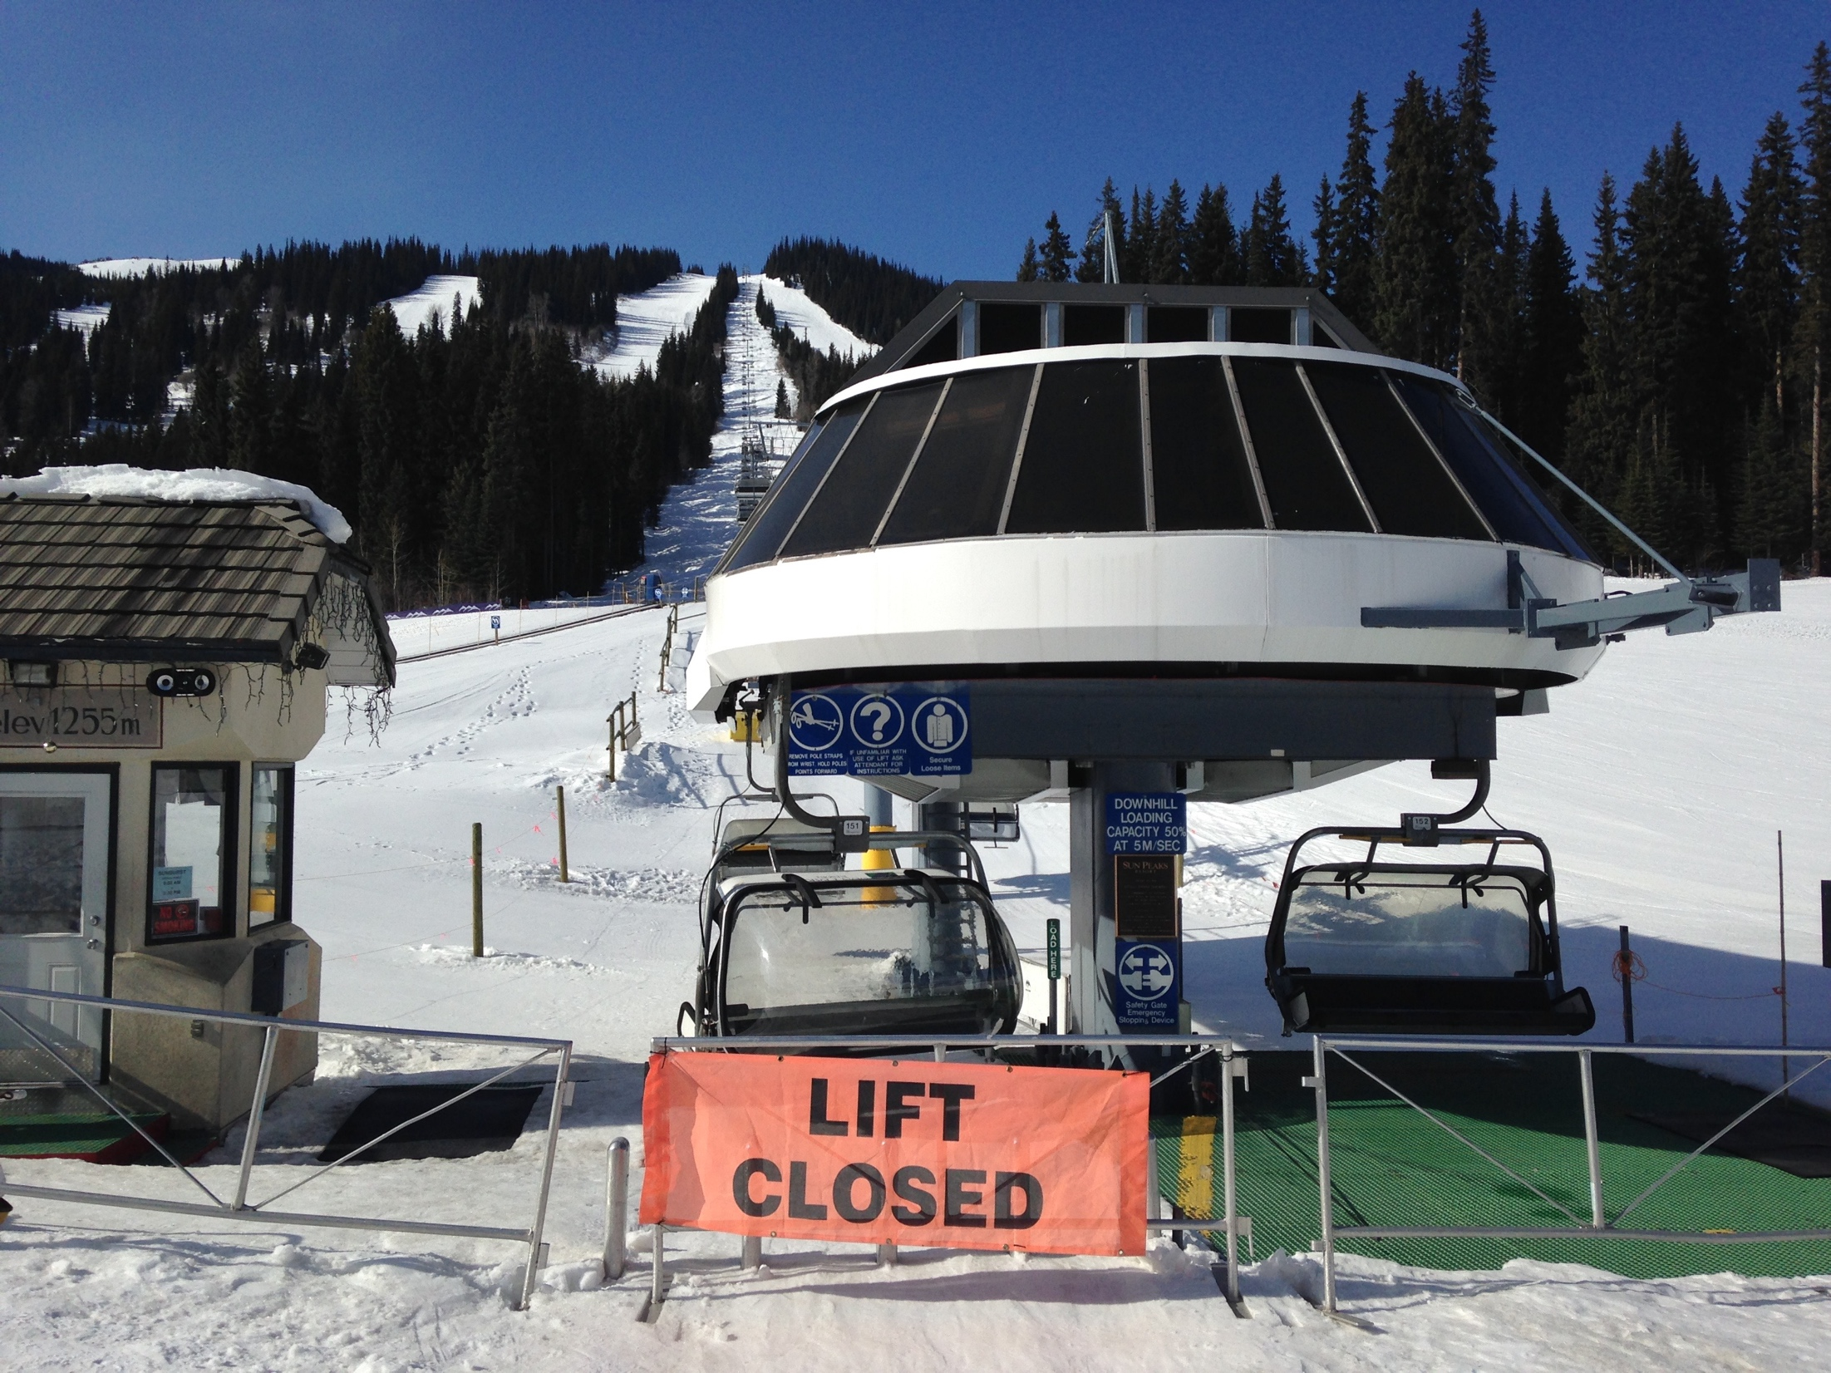
Case Study: COVID-19 and the meltdown of ski resorts
Mid-March and it was like a domino effect. One after the other - from St. Anton in Austria, to Verbier in Switzerland, to Aspen in Colorado - ski resorts around the world in swift succession announced closures amid growing coronavirus concerns.
Despite closures, the coronavirus had already ripped through well-known ski towns.
Resorts were left scrambling to deal with early closures and remain financially viable

